Slide 1
Machine Learning Method for American Option Pricing: A Comparative Study of Models Under the Heston Framework
Team Members (alphabetic):
Chengjia Dong, Ruohao Huang, Yifan Meng, Yiwen Zhang
December 11th, 2024

Slide 2
Why?
Main Structure
1. Exploratory Data Analysis (Ruohao Huang)
Sample data generation and calibration
Data generation process
Data Cleaning
2. Methodology
Evaluation Metrics
Hyperparameter Tuning: Grid Search, Optuna
Models:
Linear Models (Yifan Meng)
Ensemble Methods (Chengjia Dong)
Neural Networks (Yiwen Zhang)
3. Results
Performance Evaluation of Various Models
Model Comparison
Traditional methods, such as finite difference techniques and the Least Squares Monte Carlo method, provide reliable results but often involve high computational costs and limited scalability.
Machine Learning performs well in computational efficiency, and ability to generalize across feature spaces while maintains good accuracy
Especially useful for calibration (pretty time consuming).

Slide 3
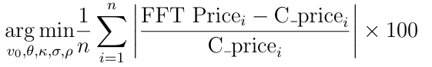


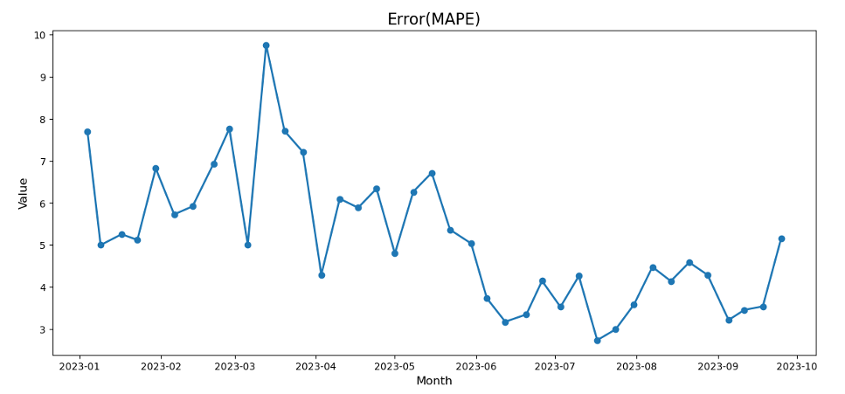
Calibration
A Nonlinear Programming Problem!
Gradient-based optimization methods
Global optimization algorithm like Differential Evolution
Minimizing MAPE
Fluctuates - likely due to increased volatility
Stays within a manageable range(below 10%)

Slide 4
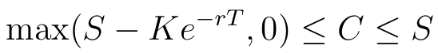
Resampling and Cleaning
New Problem!
v0​、θ、κ、σ and ρ do not follow standard distributions
Solution: Resample from empirical inverse cdf
Three Filters
Feller Condition- mathematical validity of the Heston model
IQR- detecting and removing outliers
Price Bound-

Slide 5
Application of Linear Regression in Option Pricing
Advantages of Linear Regression
Simplicity and Interpretability: Coefficients directly indicate the influence of each factor on option prices.
Computational Efficiency: Suitable for large-scale datasets.
Extensive Application: Widely used in finance, especially in option pricing.

Slide 6
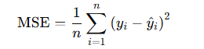
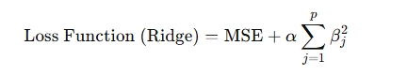
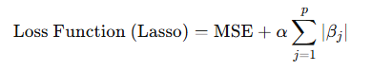
Model Training:
Employ ordinary least squares (OLS) to minimize mean squared error (MSE).
Standardize features to improve training stability.
MSE Formula:
Ridge Regularization (L2 Regularization):
Lasso Regularization (L1 Regularization):

Slide 7
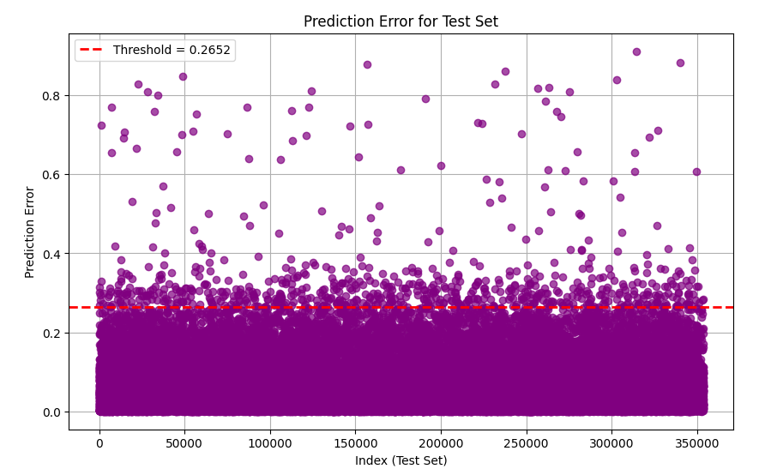
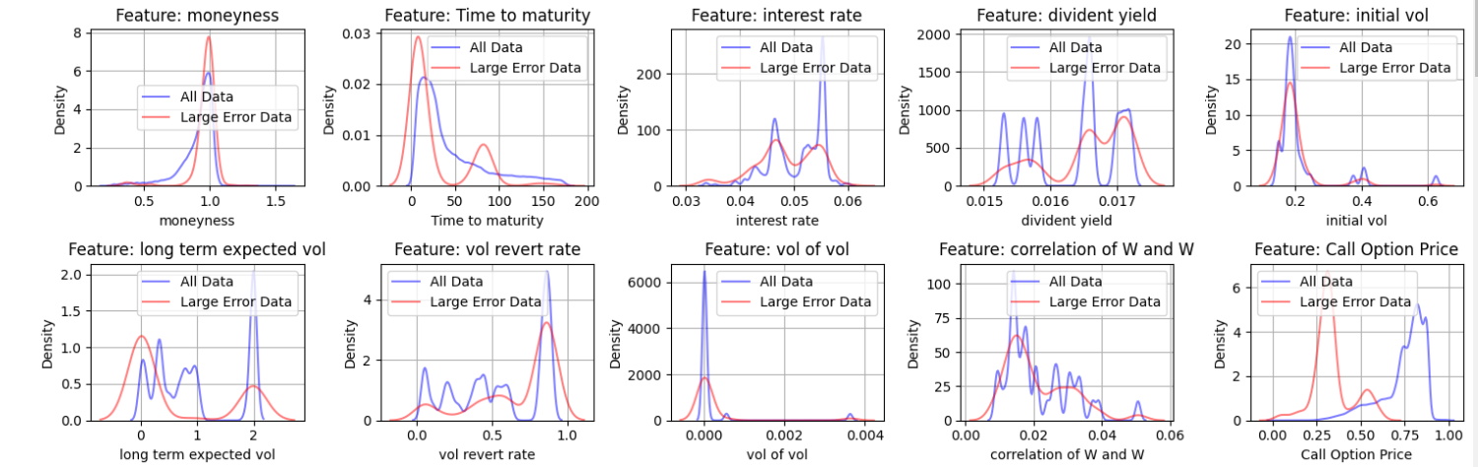
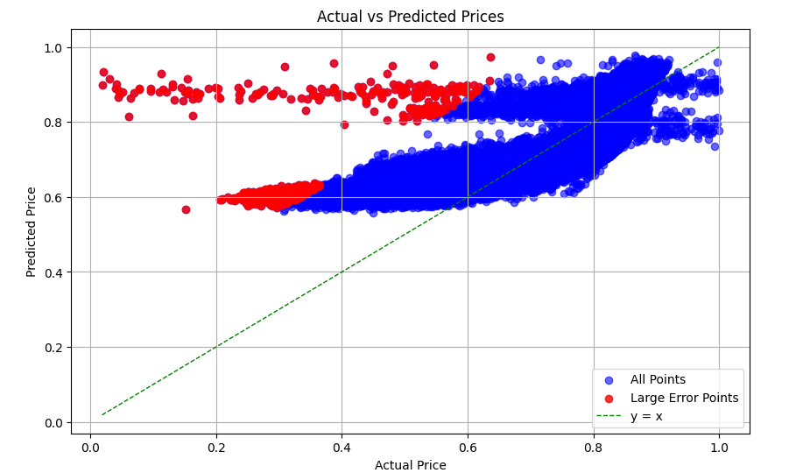
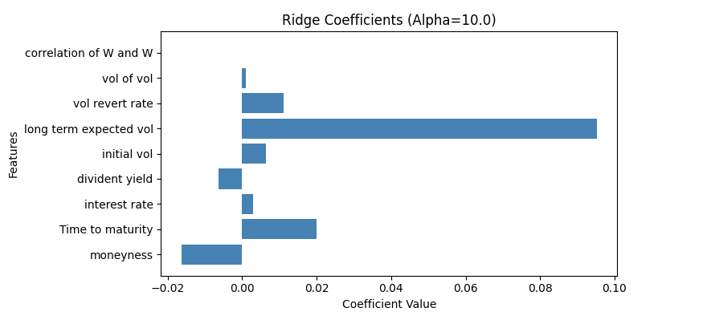
Performance of the linear regression models

Slide 8
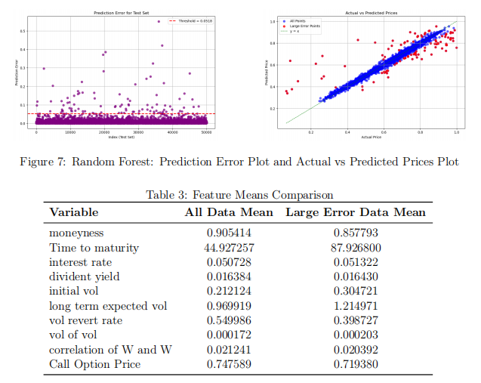
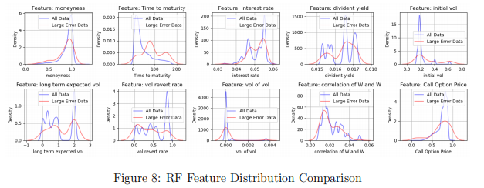
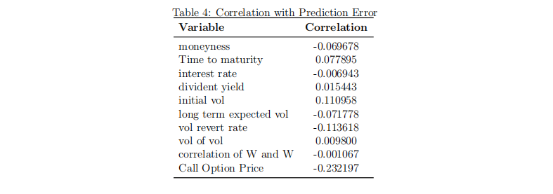
Random Forest
Training Time: 101.6661s, RMSE: 0.01696
'n_estimators': 358, 'max_depth': 22, 'max_features': None

Slide 9
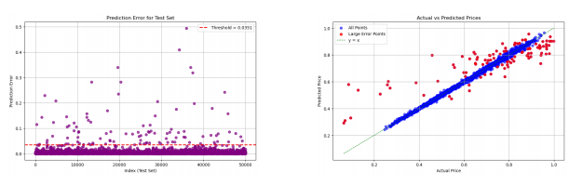
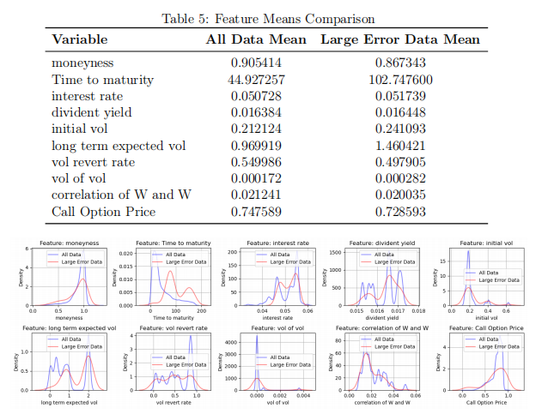
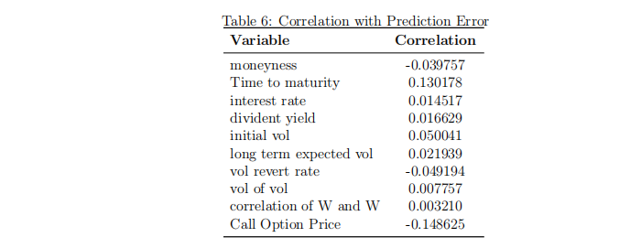
Gradient Boost Regressor
Training Time: 159.70s, RMSE: 0.01552
'n_estimators': 1700, 'max_depth': 5, 'learning_rate': 0.05721

Slide 10
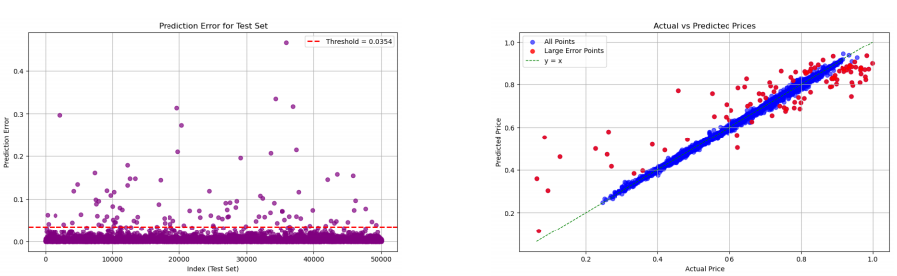
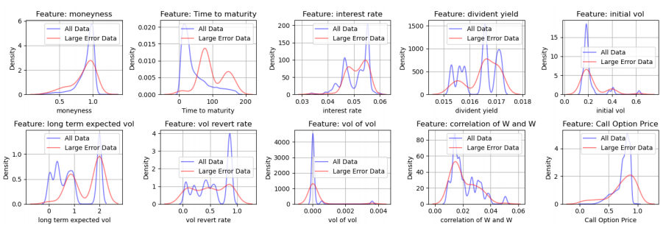
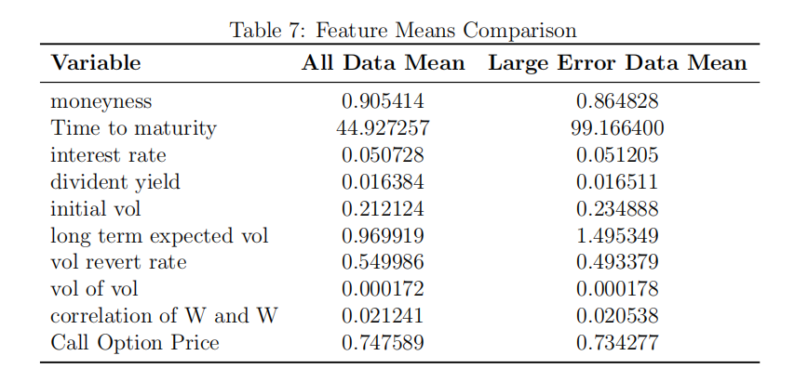
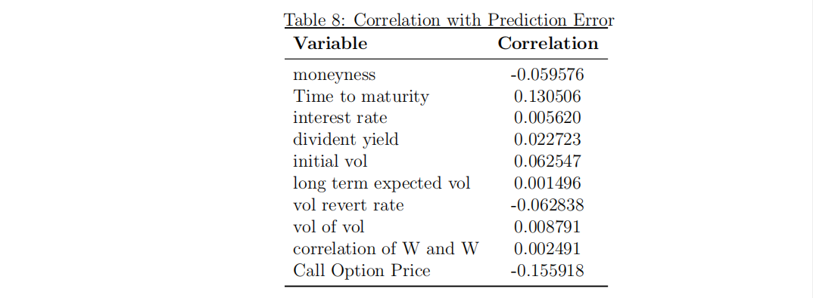
XGBoost
Training Time: 57.64s, RMSE: 0.01430
'n_estimators': 1900, 'max_depth': 7, 'learning_rate': 0.06112

Slide 11
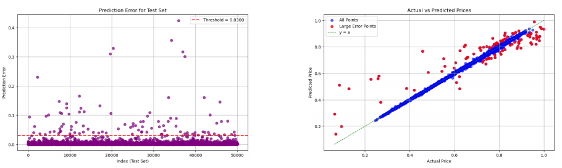
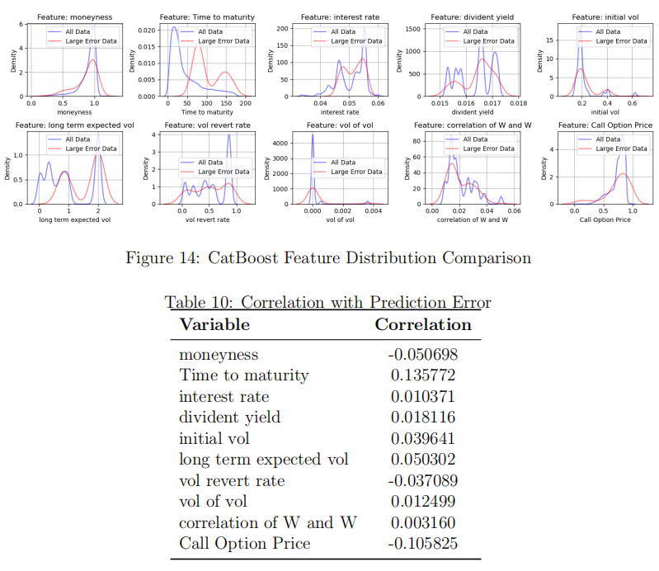
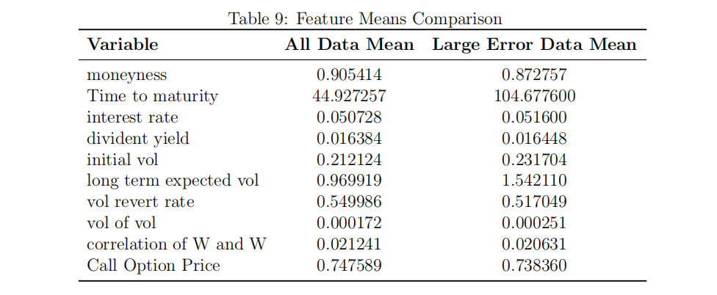
CatBoost
Training Time: 13.38s, RMSE: 0.01245
'iterations': 1800, 'depth': 7, 'learning_rate': 0.23276

Slide 12
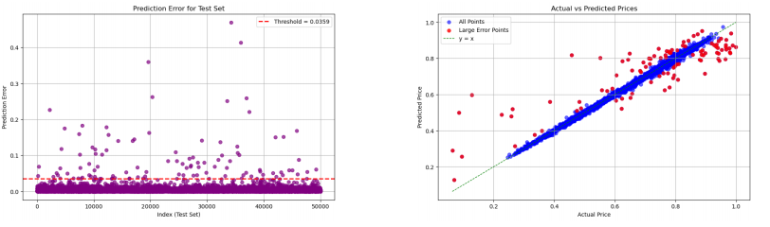
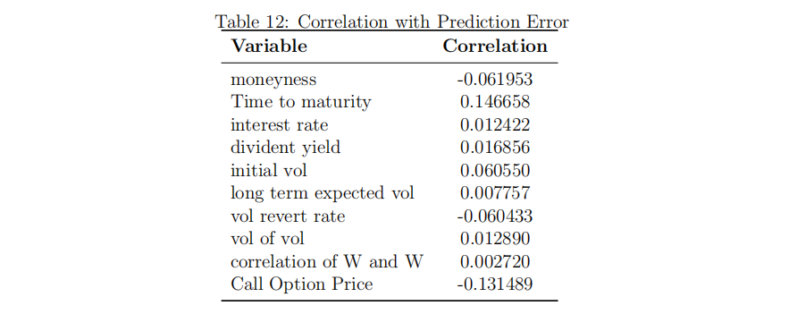
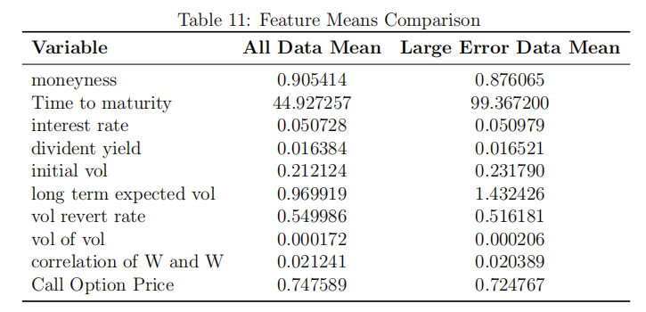
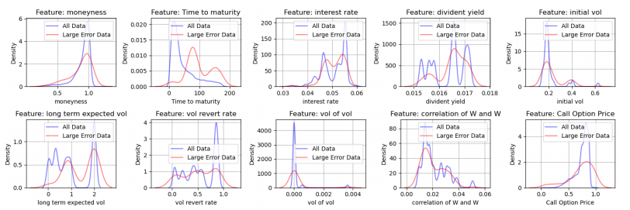
LightGBM
Training Time: 1.89s, RMSE: 0.01462
'num_leaves': 52, 'n_estimators': 877, 'max_depth': 10, 'learning_rate': 0.055193

Slide 13
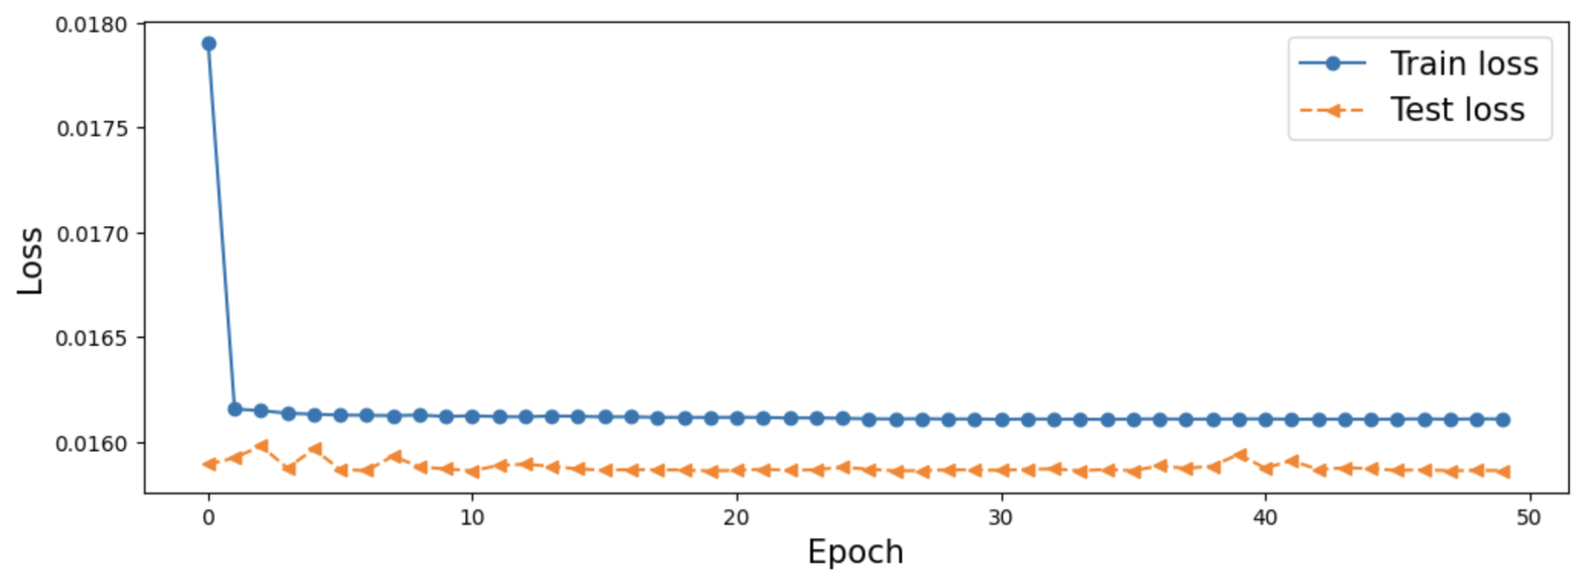
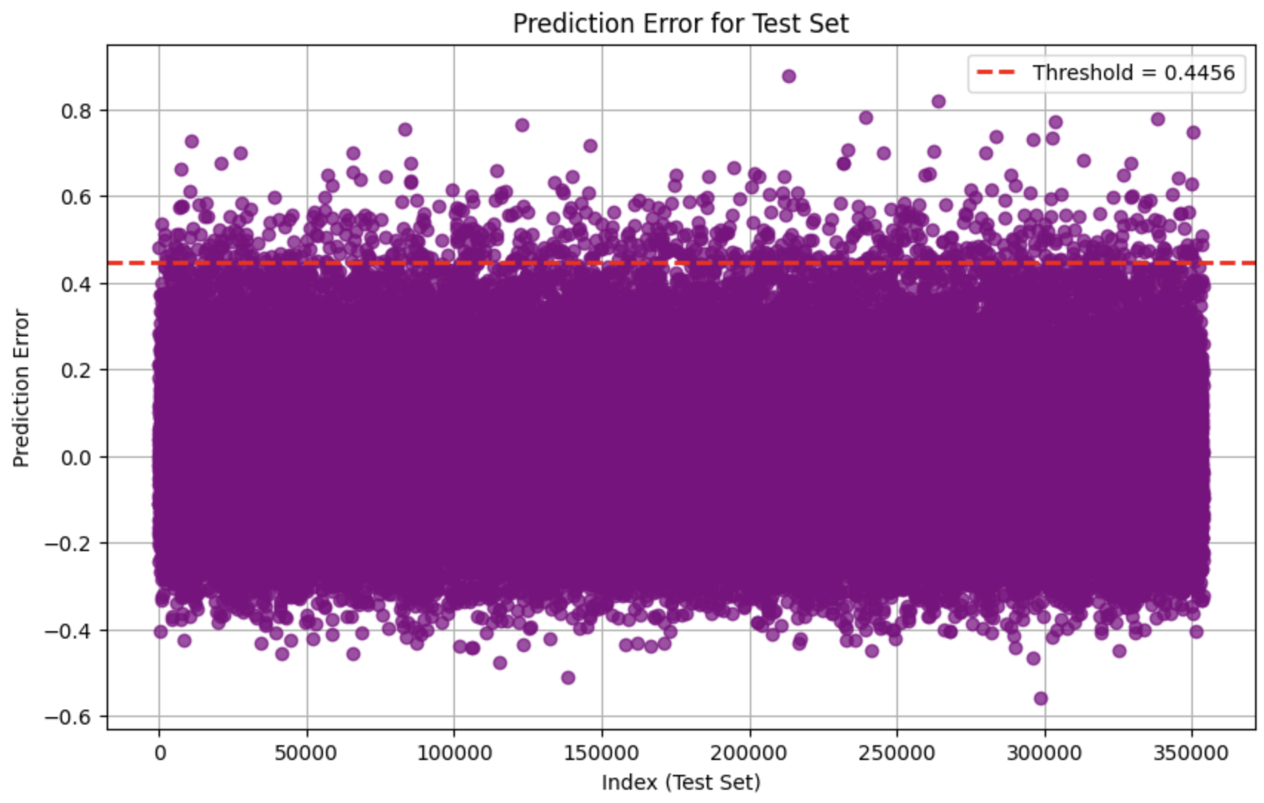
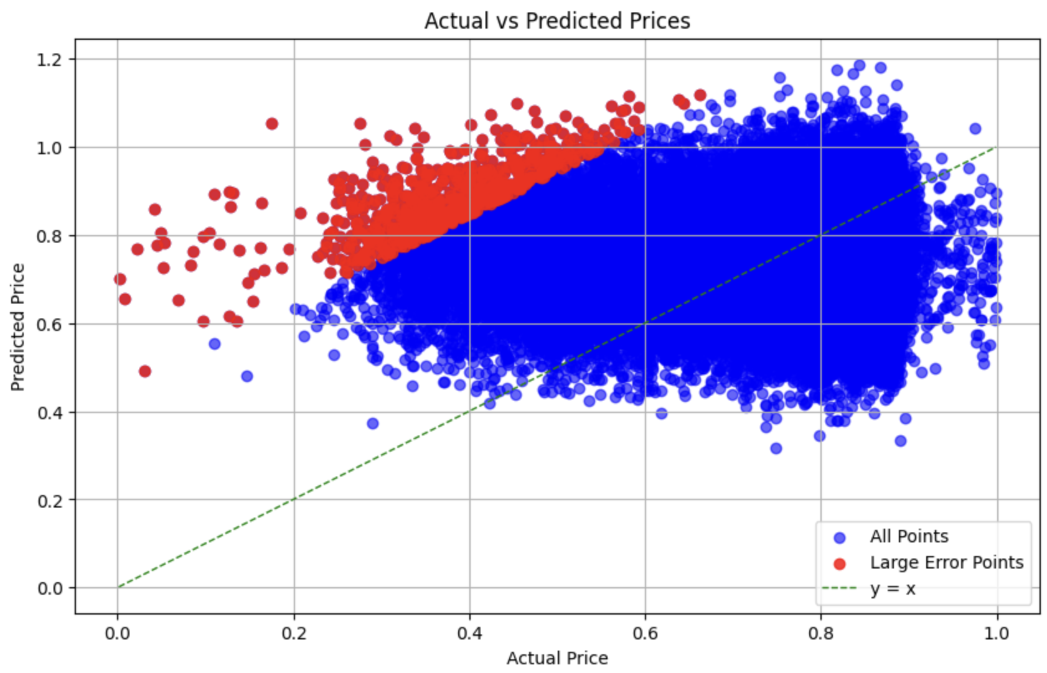
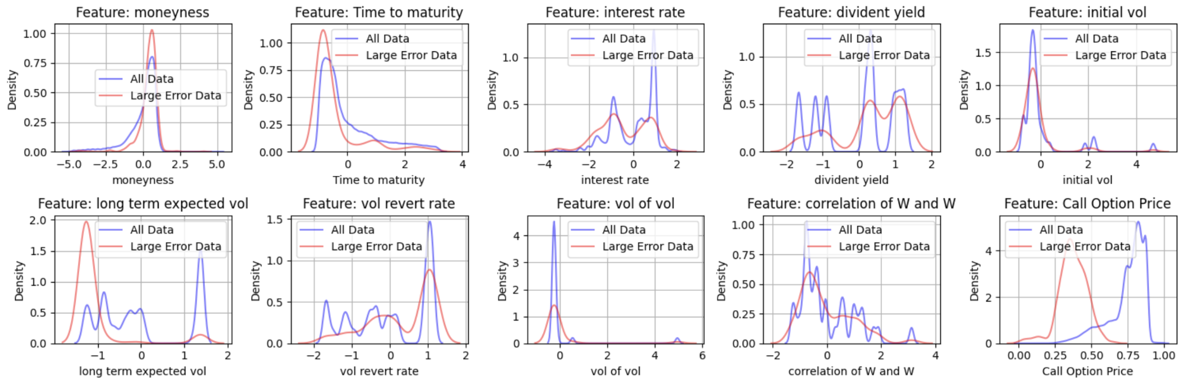
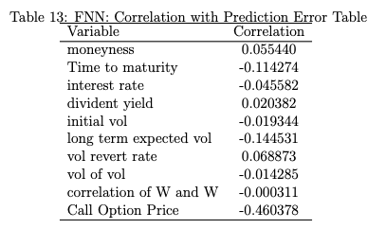
FNN (Feedforward Neural Network)

Slide 14
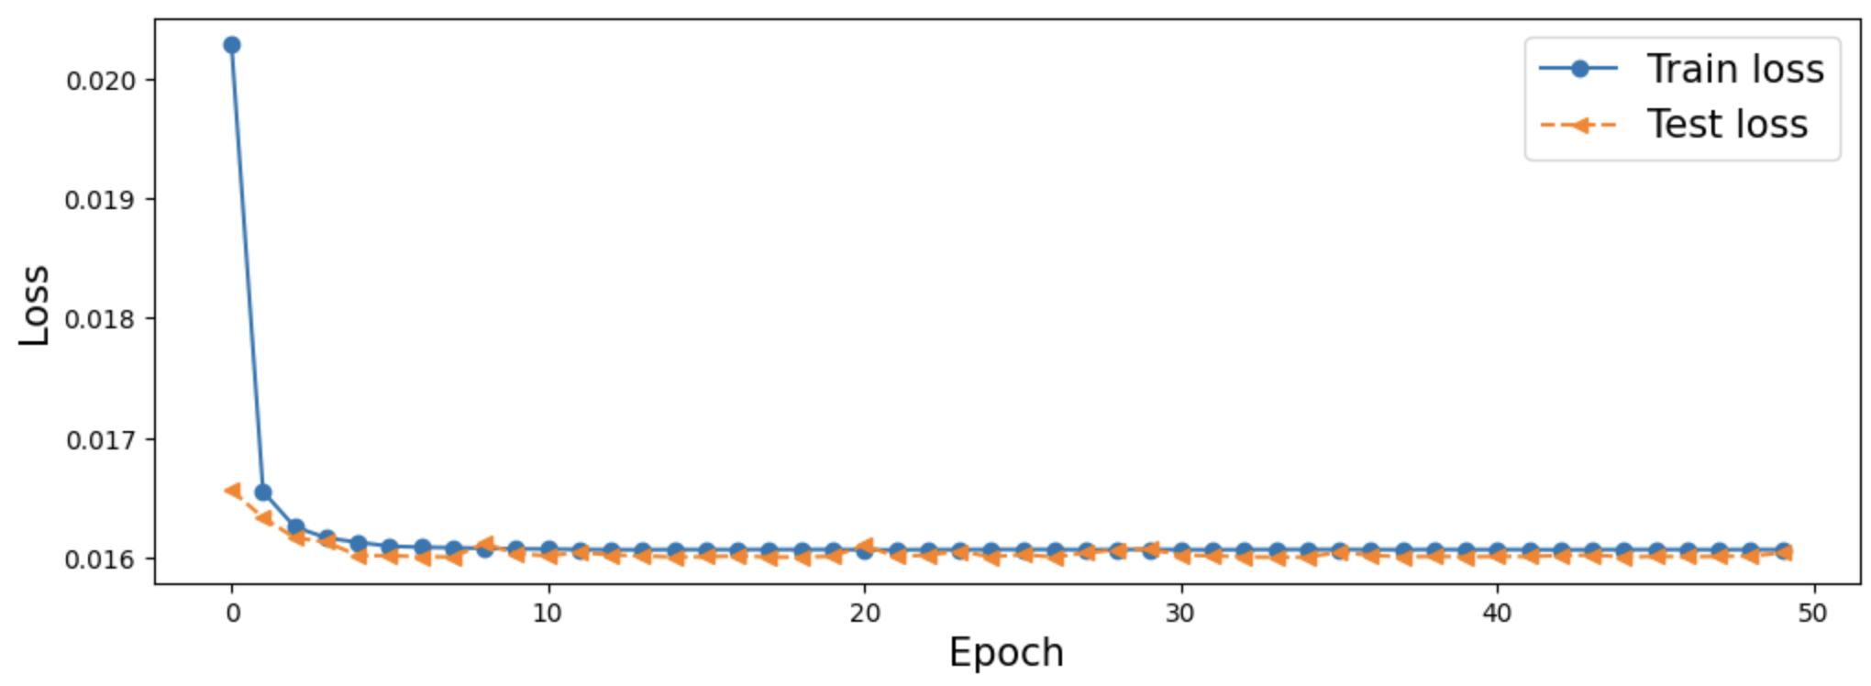
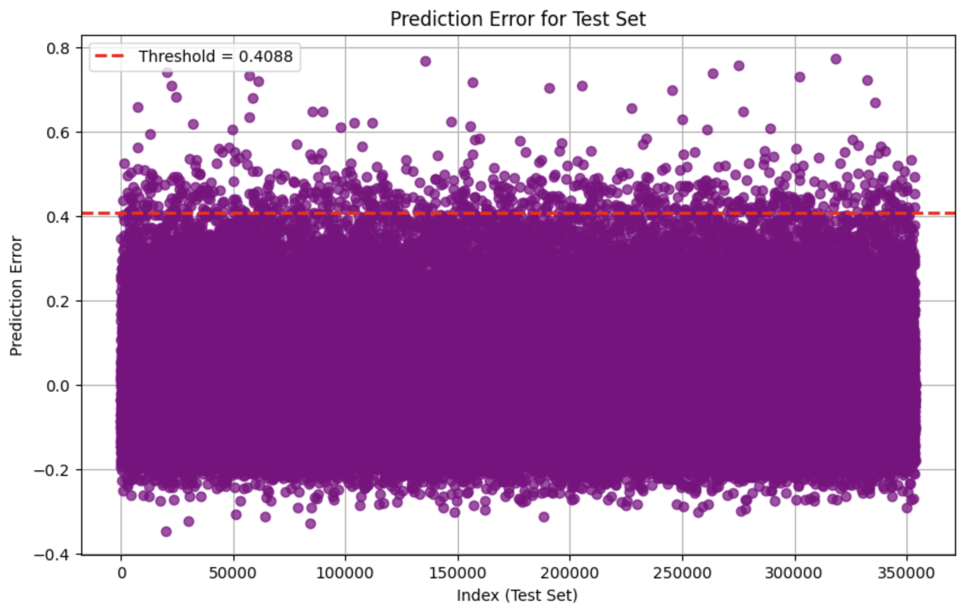
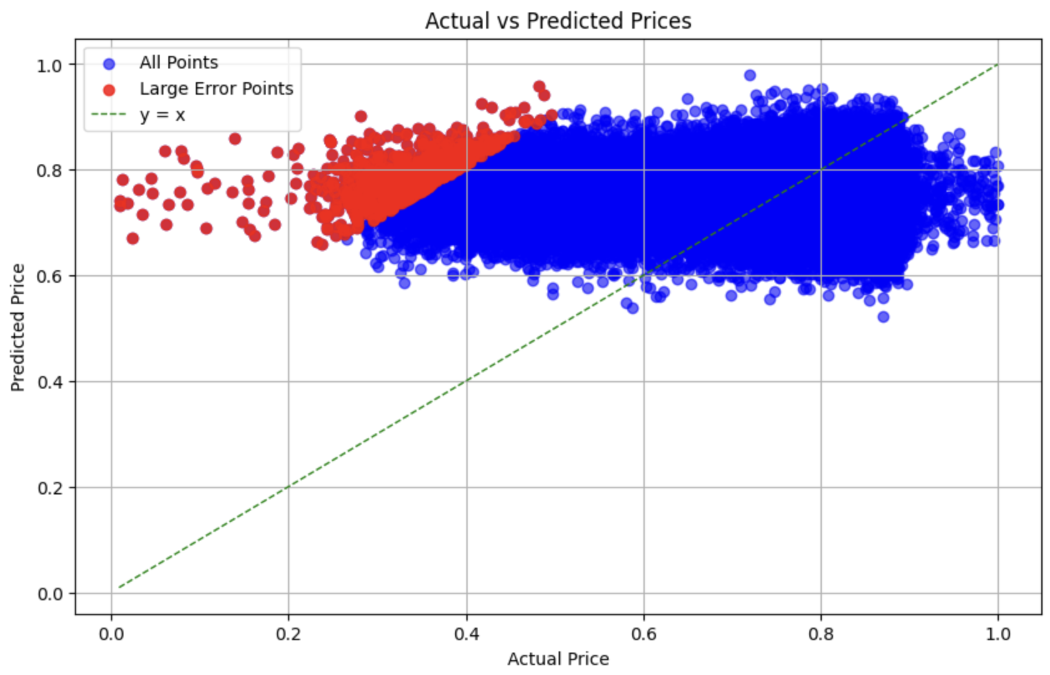
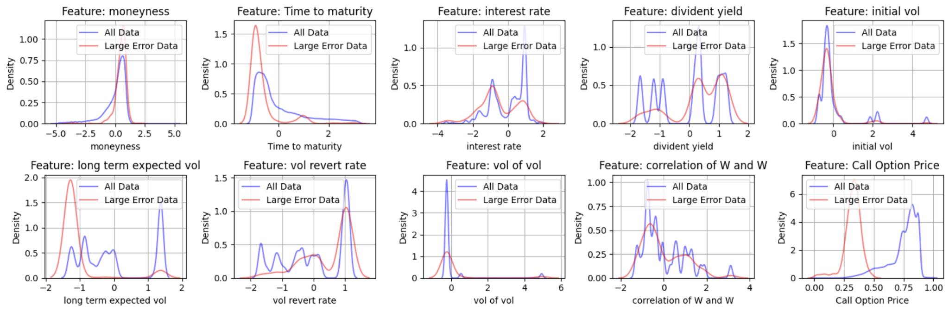
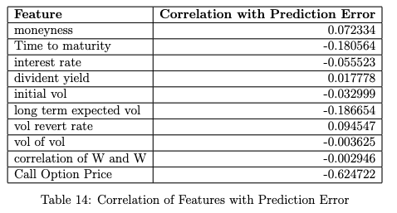
CNN (Convolutional Neural Network)

Slide 15


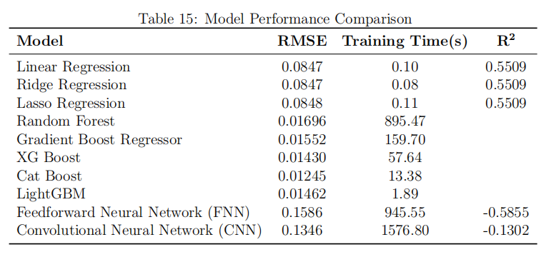
Model Comparison
Linear Models (Linear, Ridge, Lasso)
RMSE: 0.0847–0.0848, R²: 0.5509.
Extremely fast training (<0.2s), best for simple tasks.
Random Forest & Gradient Boost Regressor
RMSE: 0.0169 (RF), 0.0155 (GBR).
RF: Long training (101.661s); GBR: Balanced performance (159.7s).
Ensemble Methods (XGBoost, CatBoost, LightGBM)
RMSE: 0.0124–0.0143.
LightGBM (1.89s) and CatBoost (13.38s) are most efficient.
Neural Networks (FNN, CNN)
RMSE: 0.1586 (FNN), 0.1346 (CNN).
Long training times (>900s), limited performance.
Best Choices:
CatBoost and LightGBM for accuracy and efficiency.
Linear models for quick, low-cost tasks.

